Slide 1
Seoul Bike Sharing Demand Prediction
S. Naga Samhitha

Slide 2
Problem Description:
Currently Rental bikes are introduced in many urban cities for the enhancement of mobility comfort. It is important to make the rental bike available and accessible to the public at the right time as it lessens the waiting time. Eventually, providing the city with a stable supply of rental bikes becomes a major concern. The crucial part is the prediction of bike count required at each hour for the stable supply of rental bikes.

Slide 3
Data Set:
Date : year-month-day
Rented Bike count - Count of bikes rented at each hour
Hour - Hour of the day
Temperature-Temperature in Celsius
Humidity - %
Windspeed - m/s
Visibility - 10m
Dew point temperature - Celsius
Solar radiation - MJ/m2
Rainfall - mm
Snowfall - cm
Seasons - Winter, Spring, Summer, Autumn
Holiday - Holiday/No holiday
Functional Day – No Func (Non Functional Hours), Fun(Functional hours)

Slide 4
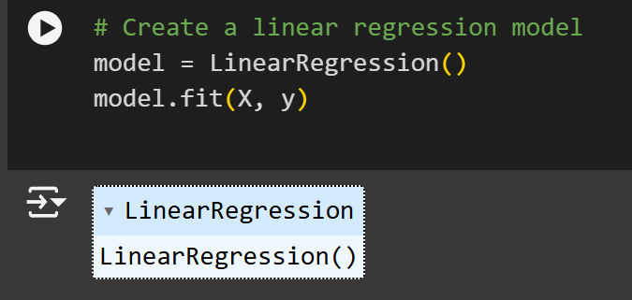
Creating Linear Regression model

Slide 5
By these we can predict the Y values

Slide 6
Plotting the linear Regression graph through by Comparing Temperature and Rented bike count

Slide 7
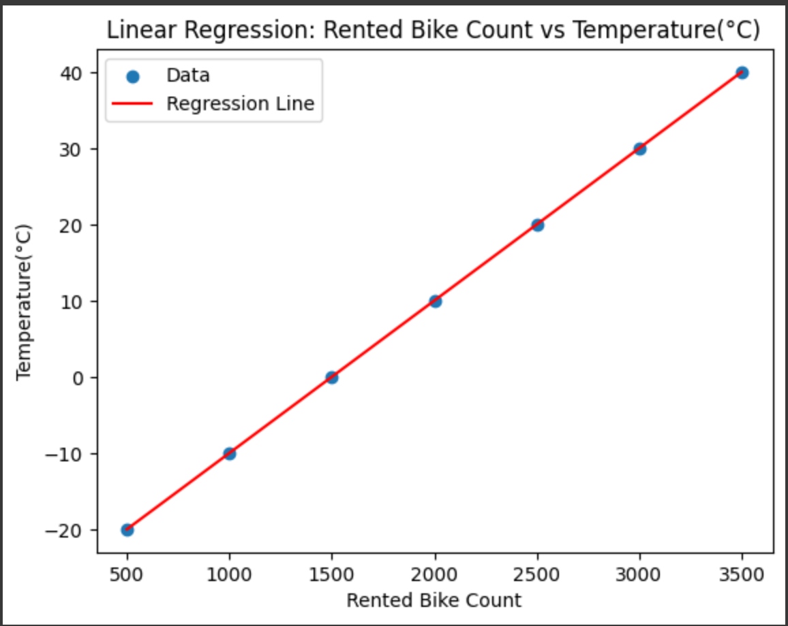

Slide 8
IN R PROGRAMMING
First Install packages in R studio
install. packages("ggplot2")
library(ggplot2)
After installing Library Download Data from Your directory

Slide 9
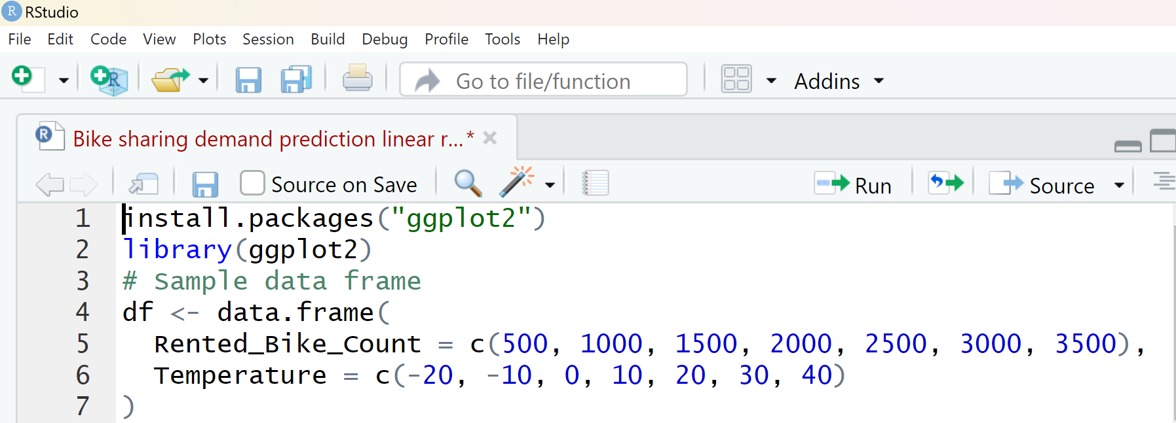

Slide 10
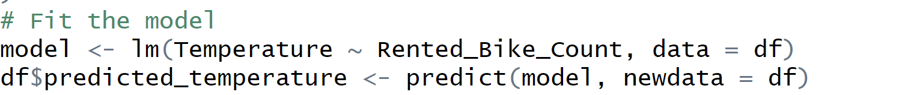
Fit The Model From Your Data and Predicted Data

Slide 11
Now Plot The Linear Regression With ggplot2
# Plotting with ggplot2
ggplot(df, aes(x = Rented_Bike_Count, y = Temperature)) + geom_point(color = 'blue', size = 3) + # Plot the data points geom_line(aes(y = predicted_temperature), color = 'red', size = 1) + # Add the regression line labs( title = 'Linear Regression: Rented Bike Count vs Temperature',
x = 'Rented Bike Count’,
y = 'Temperature (°C)' ) +
theme_minimal() + # Use a minimal theme for better aesthetics theme( plot .title = element_text(hjust = 0.5),
# Center the title axis. title = element_text(size = 12) # Increase axis title size )

Slide 12
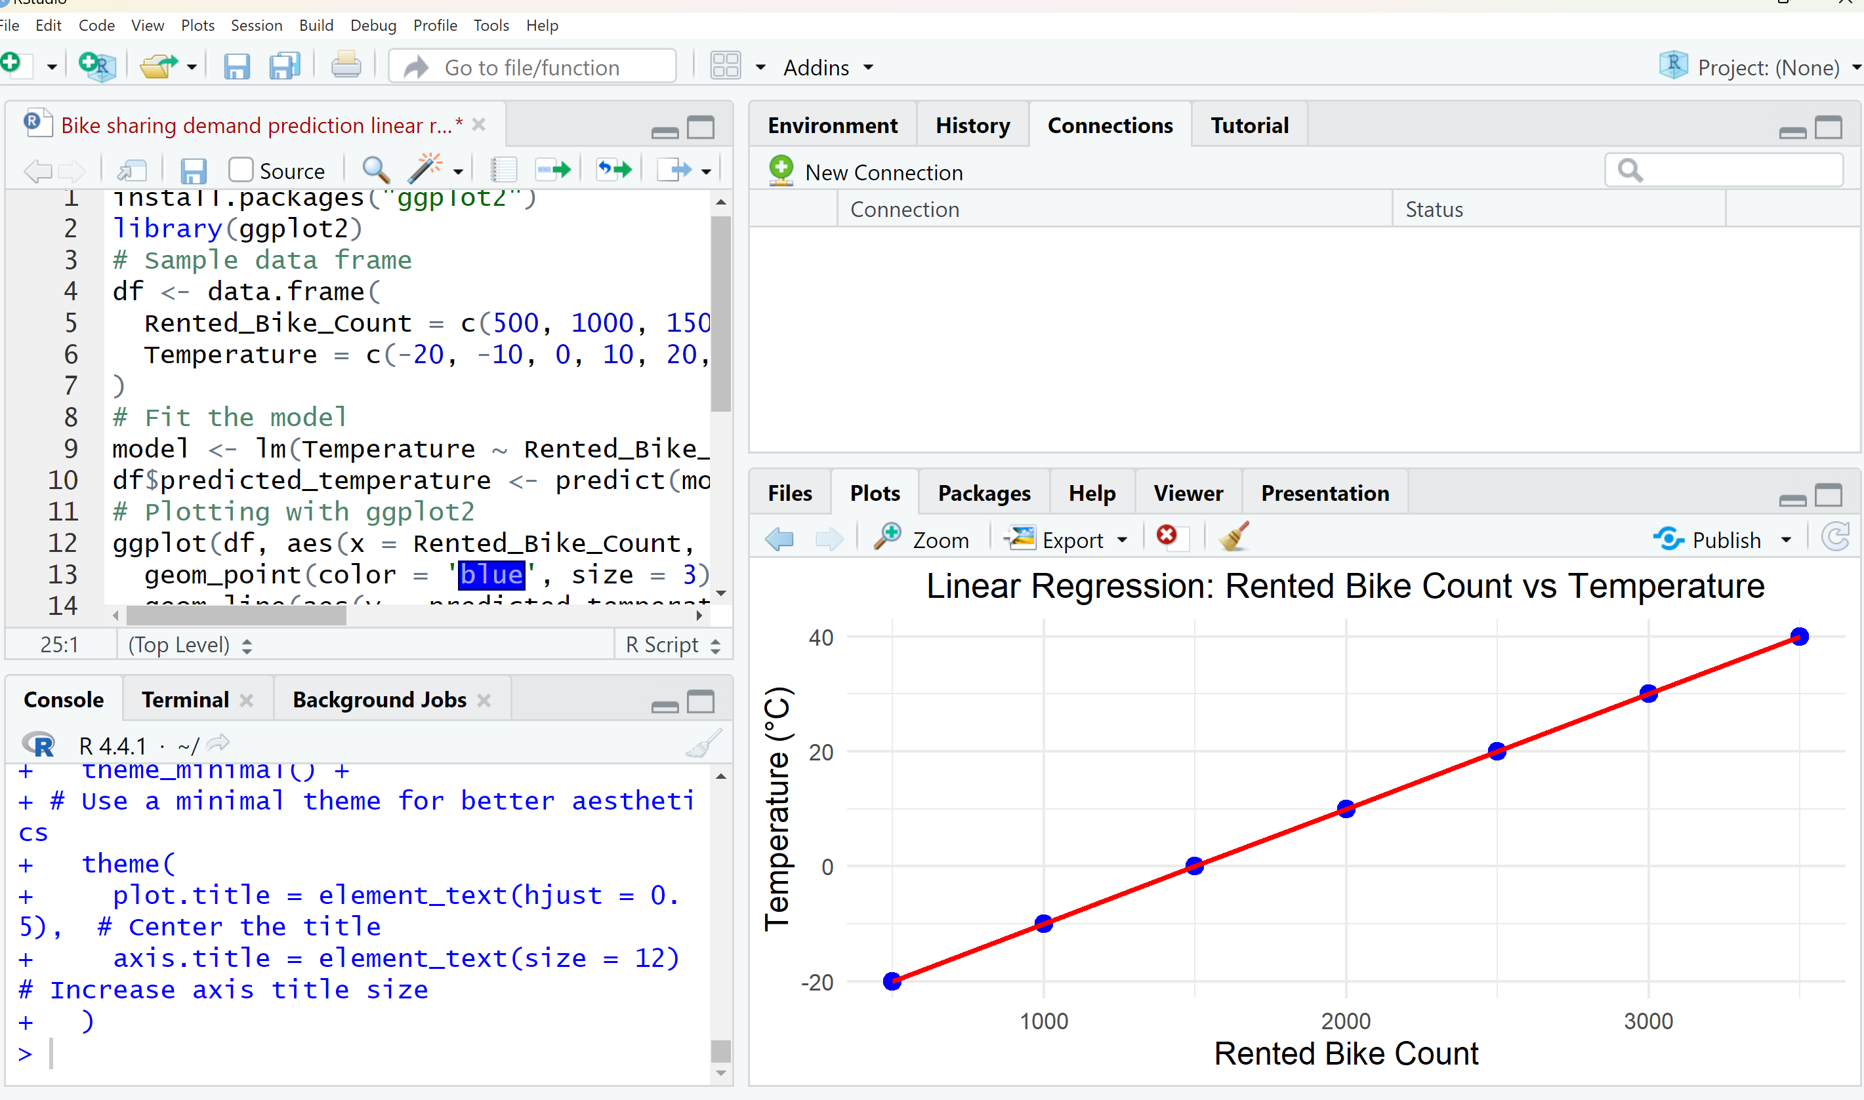

Slide 13
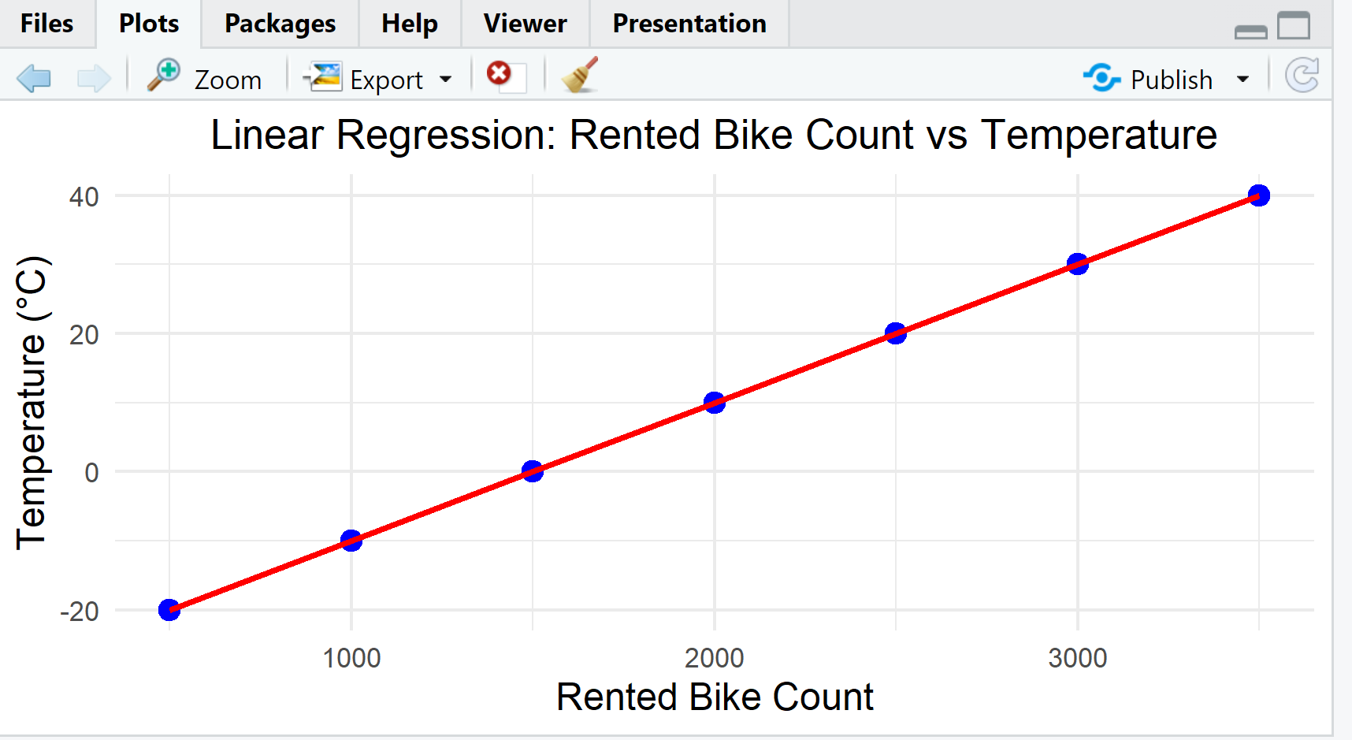
The Final Result Of The Graph in R program:

Slide 14
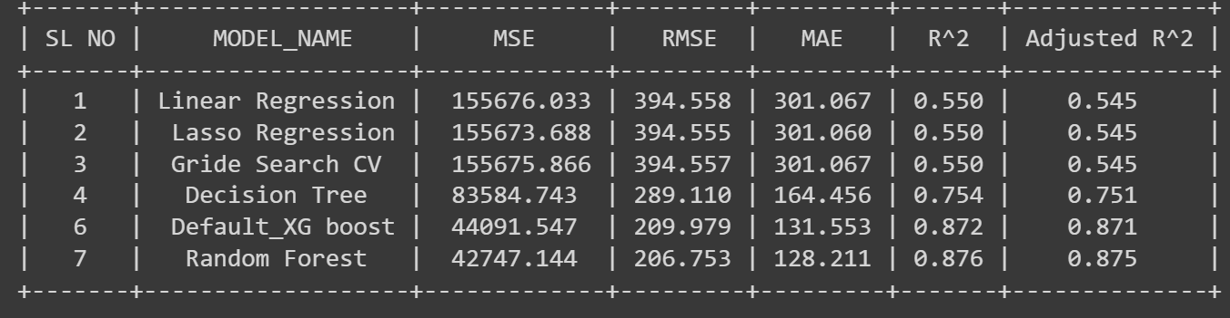
Summary of ML model

Slide 15
Conclusion:
Here We can do Linear Regression of given Data in both R Programming and Python
In Python we can plot the linear Regression graph through python code and in google colab
In the R programming we can plot graph through installing the packages in R studio After installing the library
we can plot the linear Regression graph through our Given Data.

Slide 16
THANK YOU

